Slide 1
Modeling Omega HED and ICF Experiments with MARBL
Jeremy Binagia
Mentor: Luc Peterson
September 9th, 2020
Notes:
5th year Phd student at stanford
---
20 s

Slide 2
Outline for Today
Introduction to MARBL, a next-gen multiphysics code
Part I: Radiation Kelvin-Helmholtz Instability in a Magnetic Field
Part II: Modeling the microstructure of HDC ablators in rad-hydro simulations
Notes:
---
35 s

Slide 3
Outline for Today
Introduction to MARBL, a next-gen multiphysics code
Part I: Radiation Kelvin-Helmholtz Instability in a Magnetic Field
Part II: Modeling the microstructure of HDC ablators in rad-hydro simulations

Slide 4
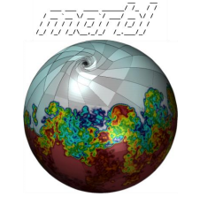
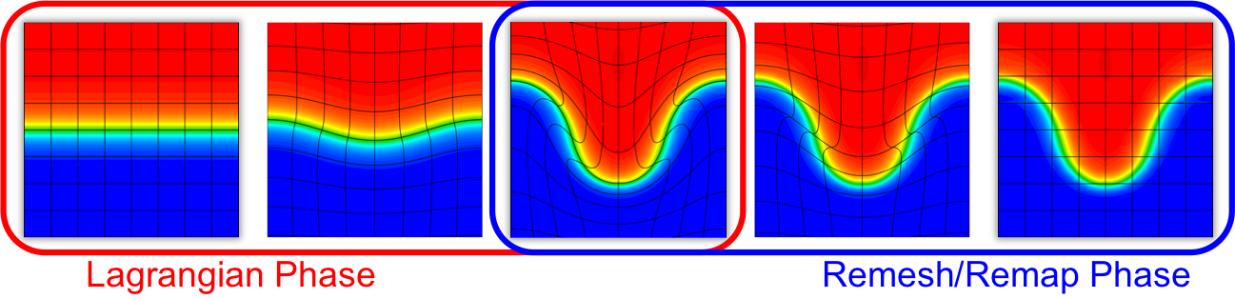
The next-gen code MARBL has recently added physics necessary to model complex HED systems
Some of the strengths of MARBL include
High order finite elements
Flexible Lua interface
Axom: Modular CS infrastructure
Ascent in-situ visualization
BLAST: Arbitrary Lagrangian-Eulerian (ALE) package for simulating magneto-radiation-hydrodynamics phenomena
Bottom: https://computing.llnl.gov/projects/blast
Notes:
Next-gen code being developed at the lab that’s approaching the point where it can be used to model new physical phenomena
Lots of strengths, most notably the use of high order finite elements, which you can see in the picture below…
To simulate magneto-radiation-hydrodynamics phenomena, MARBL uses BLAST, which is an arbitrary lagrangian-eulerian or ALE code
This means is…
---
1 min 15 s
---
Why high order is good:
great flop/byte ratio which is important for exascale computing where you really don’t want any nodes to be sitting idle
Subzonal resolution
Great picture since it illustrates
High order elements (subzonal resolution and curvilinear shape)
ALE
From BLAST webpage: BLAST also provides a high performance computing advantage since high-order methods have greater FLOP/byte ratios, meaning that more time is spent on floating point operations relative to memory transfer, an important characteristic of numerical algorithms for exascale computing.
Axom:
Its principal goal is to provide a collection of robust and flexible software components that serve as building blocks for LLNL simulation tools. The emphasis is on sharing core infrastructure software amongst applications rather than having different codes develop and maintain similar capabilities

Slide 5
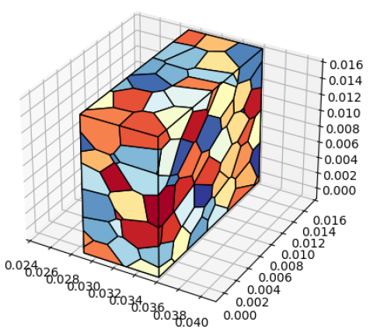
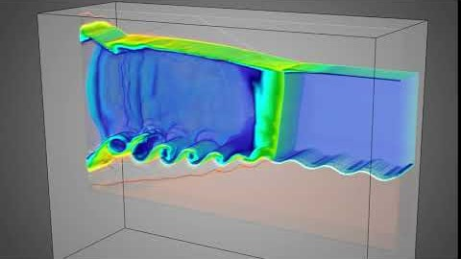
The two projects I worked on demonstrate MARBL’s strengths and unique capabilities
Radiation Kelvin-Helmholtz Instability with a Magnetic Field
Modeling HDC* microstructure in a rad-hydro simulation
*HDC – high density carbon
Left: MARBL RKH simulation: https://www.youtube.com/watch?v=J-ANLAnc6WI
Notes:
RKH-MHD
Here is a simulation without the magnetic field in MARBL to give you an idea of what this looks like
RKH-MHD was first simultaneous use of radiation and MHD capabilities
HDC:
In this problem, the subzonal resolution afforded by high order elements help resolve the flow that emerges as a shock passes through this microstructure

Slide 6
Outline for Today
Introduction to MARBL, a next-gen multiphysics code
Part I: Radiation Kelvin-Helmholtz Instability in a Magnetic Field
Part II: Modeling the microstructure of HDC ablators in rad-hydro simulations

Slide 7
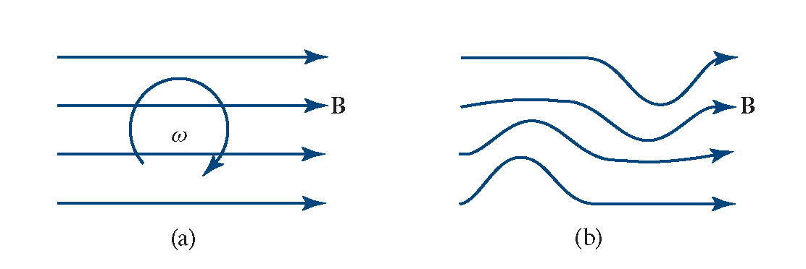
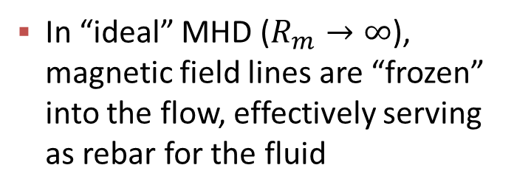
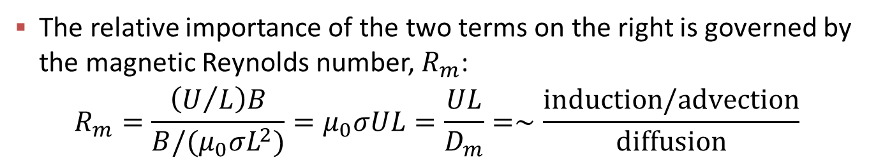

Magnetic fields can potentially suppress the growth of fluid instabilities
The induction equation describes the evolution of a magnetic field in a conducting fluid with conductivity $σ$:
$$\frac{∂B}{∂t}=∇×\left(u×B\right)+\left(\frac{1}{μ_{0}σ}\right)∇^{2}B$$
The relative importance of the two terms on the right is governed by the magnetic Reynolds number, $R_{m}$:
$$R_{m}=\frac{\left(U/L\right)B}{B/(μ_{0}σL^{2})}=μ_{0}σUL=\frac{UL}{D_{m}}=∼\frac{induction/advection}{diffusion}$$
In “ideal” MHD ($R_{m}→∞$), magnetic field lines are “frozen” into the flow, effectively serving as rebar for the fluid
Notes:
First background on how magnetic fields can potentially suppress fluid instabilities
Evolution of a magnetic field in a conducting fluid (PERIOD).
What is the magnetic Reynolds number
In the ideal MHD limit corresponding to infinite conductivity, the field lines are perfectly advected by the fluid with no diffusion – i.e. they are frozen into the fluid
But as the fluid flows these field lines are going to resist deformation and hence would suppress growth of instabilities
---
Part of my summer work is to explore how applying a magnetic field can suppress the KH instability
The idea behind this is that in the limit of ideal magnetohydrodynamics or MHD, which corresponds to infinitely large electrical conductivities, the magnetic field lines are effectively “frozen into” the fluid and move with it. Of course, as the fluid deforms though, these field lines resist deformation, and thus could be thought of as adding “structural support” to the fluid
To explore this, we plan to use MARBL, a brand-new next-gen multi-physics code to conduct 3D simulations of the experimental setup I mentioned earlier (and shown in detail on the bottom left) but now in the presence of a magnetic field.
As an example I’ve shown to the right a MARBL simulation of the nominal radiation-driven KH experiment, that is without the magnetic-field
Importantly, these new simulations will mark the first time that both radiation and MHD are being enabled simultaneously in MARBL so this project has the added benefit of aiding the developers working on this codebase
---
https://www.youtube.com/watch?v=J-ANLAnc6WI – marbl. Exascale computing project.
Fig. 1: Density contour plot from a 2D ARES simulation at around 40 ns, where the density is plotted on a logarithmic color scale for visualization.

Slide 8
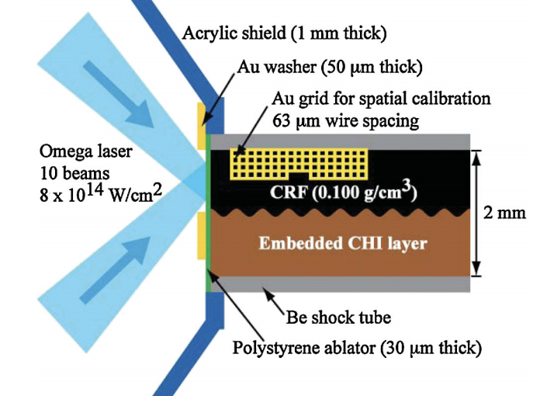
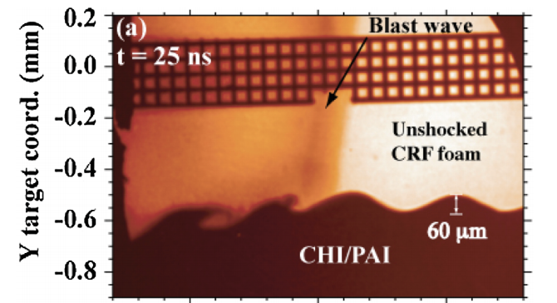
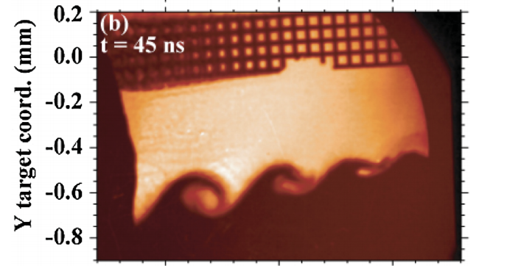
An experiment at Omega plans to explore this in the context of the radiation Kelvin-Helmholtz instability
The Rad-KH instability has been previously demonstrated in a HED environment using the setup shown to the right:
Experimental schematic
Idea is to repeat w/ uniform B-field oriented in the shock direction
Our goal is to try and model this new experiment using MARBL
Harding, E. C. et al. Phys. Rev. Lett. 103, 1–4 (2009).
Notes:
Thinking along these lines, scientists are currently setting up and planning an experiment at Omega to explicitly explore this phenomena
Apparatus is based on previous experiment without b-field. Shock tube with light foam atop a denser plastic with an initially perturbed interface
By shining lasers beside the less dense material on top, send a shock wave through the tube from left to right that creates the KH rollups
Repeat this with specified b-field orientation
We want to model this using MARBL to see if we can indeed see suppression
---
1 min?

Slide 9
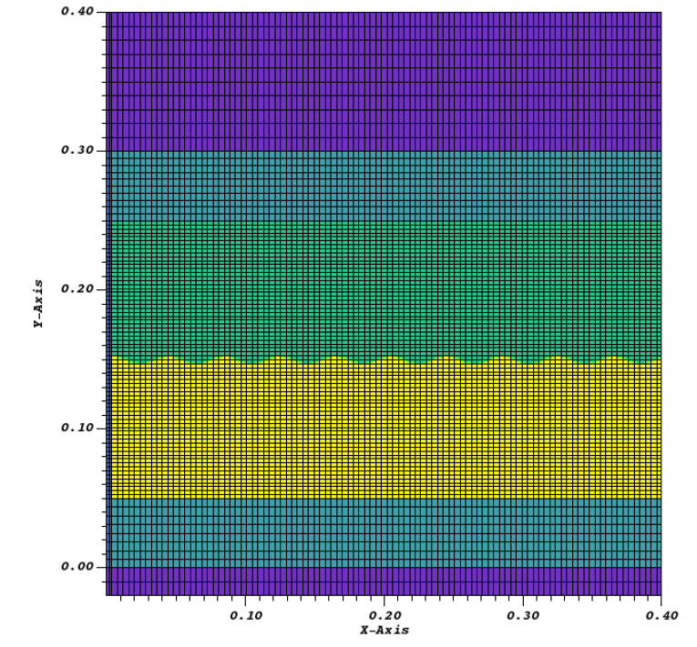
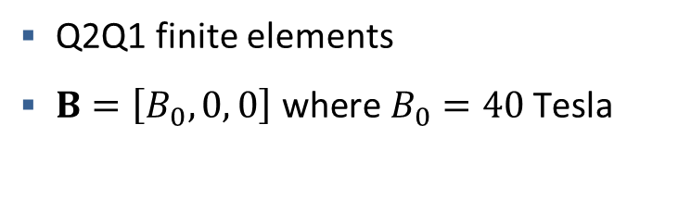
The numerical setup is designed to closely mimic the experimental configuration
Air
Be
Foam
Ablator
Numerical considerations
Plastic
Q2Q1 finite elements
$B=\left[B_{0}, 0, 0\right] \text{where} B_{0}=40 \text{Tesla}$
Shock driven by 90 kJ of radiation energy deposited in the upper region of the ablator (next to the foam) for 1 ns. Simulation runs for 120 ns.
Top left: Harding, E. C. et al. Phys. Rev. Lett. 103, 1–4 (2009).
3D RKH simulations w/o MHD: Raman, K. S., et al. Physics of Plasmas 19.9 (2012): 092112.
Notes:
Setup in marbl closely resembles the experimental apparatus
Iterate points on left
Q2Q1 = Quadratic velocity, linear pressure
Uniform 40 Tesla magnetic field oriented in the shock direction, that is to the right of the page
And in this case we drive the shock by depositing…
---
1 min 15 s

Slide 10
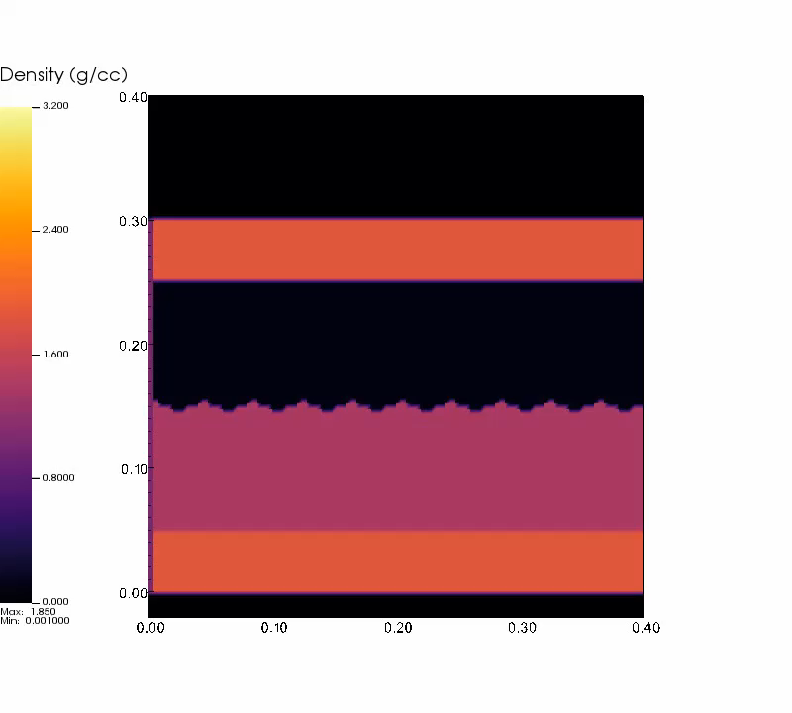
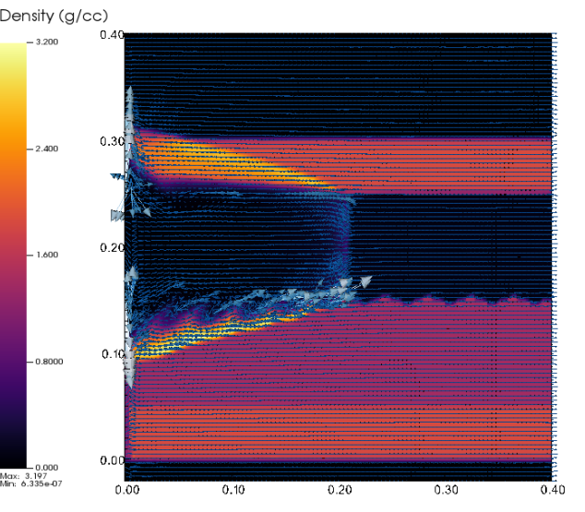

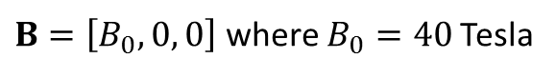
Early results (ideal MHD) were difficult to resolve and suggested the need for resistivity
Density vs. time
Magnetic field at $t≈4.0$ns
Jet of material along left-hand side boundary causes simulation to terminate prematurely around $t≈4.2$ ns upon impacting upper boundary of domain
$B=\left[B_{0}, 0, 0\right]$ where $B_{0}=40$Tesla
Notes:
PITHY
Early results plotting density as a function of time
Unfortunately, simulation crashes in what we now believe was a result of assuming ideal MHD
Tried to illustrate this on the right with a plot of the magnetic field but in essence what happens
---
50 s
---
Density video of that simulation
Maybe a second video of B-field. Material shooting up side cause no Joule heating. Motivation for adding in resistivity.

Slide 11
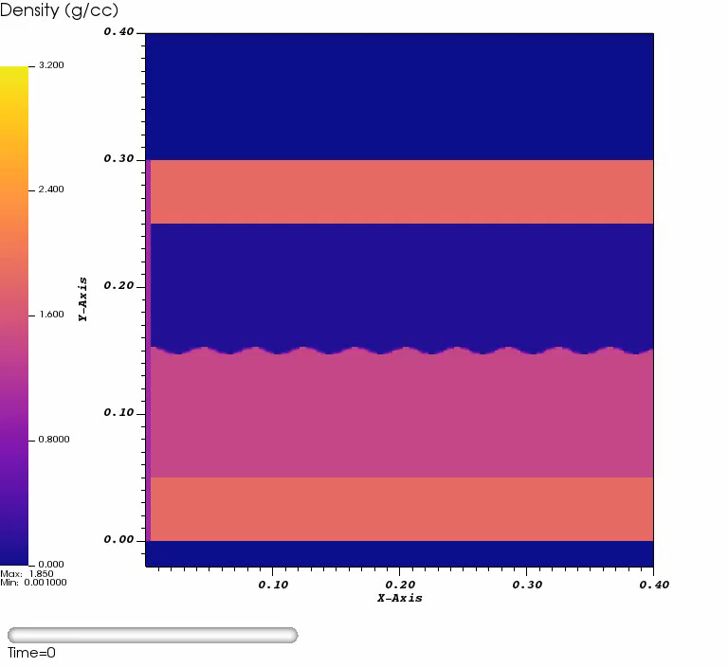
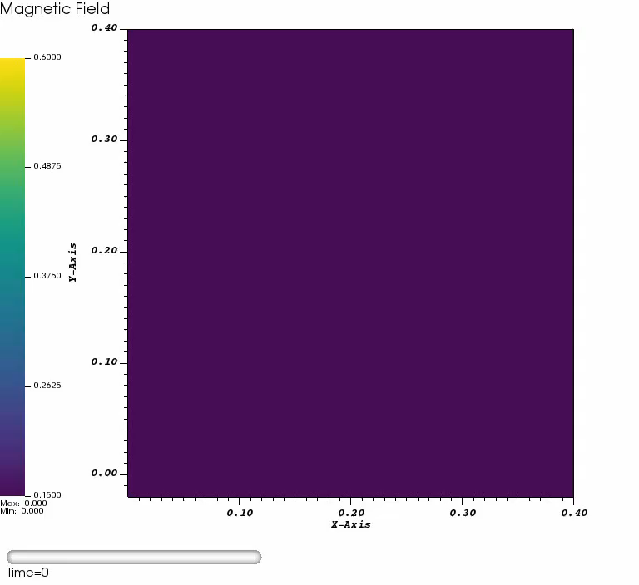
Latest results with resistivity progress further but still suffer from numerical challenges
Density vs. time with B-field (arrows)
Magnetic field strength vs. time
$B=\left[B_{0}, 0, 0\right]$ where $B_{0}=40$Tesla
Notes:
Finite resistivities to ameliorate this and simulation reaches about 50% further
Still trying to understand what is causing the numerical crash in this scenario
For example if we visualize the magnitude of the magnetic field, it appears that most of the perturbation to the applied field actually happens in the surrounding Be tube and the air and not near the perturbed interface as we might expect
So this is something we’d like to investigate further
---
1 min
---
Latest from Rob: “An update on the 3D MHD problem. I did some runs where I a lowered the CFL multiplier from its default of 0.5 to 0.25 and i was able to run longer for the B=40 case (for the stress option discussed above). The B=0 case ran just fine for me (even at double the resolution you have been running at). This is evidence of an explicit time stepping instability for the MHD stress contribution to the hydrodynamics (also clearly shown in the movie you sent). I had a chat with White, Dan this morning and our current thinking is that there may a bug in how the CFL condition for the Alfven wave speed is being computed or possibly some double counting of the MHD stress/force. This is something that has been extensively tested before for many MHD benchmarks, but there have been several updates to the core hydro force algorithm over the past several months and its possible our regression tests missed something. ”

Slide 12
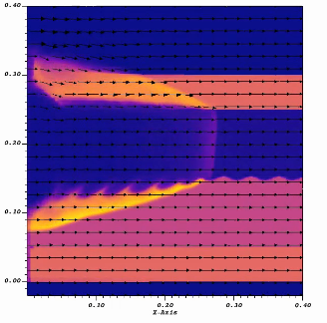
Key takeaways and future work for Part I
Key takeaways
First application of MARBL utilizing both MHD and radiation transport
Early results are promising but the simulations require further tuning in order to be able to run to late times
Future work
Continue to iterate on numerical challenges
Consider using more realistic conductivities for fully ionized plasmas
Notes:
In terms of key takeaways, I’d like to point out again that…
Good opportunity to put marbl to the test in that regard
In terms of instability suppression, we are making progress but moving forward we’d like to continue to iterate on the numerical challenges I mentioned as well as to consider more realistic conductivity values for some of these materials
---
50 s
---
Lessons learned from MARBL and this problem
Maximum tmop limit scale isn’t better

Slide 13
Outline for Today
Introduction to MARBL, a next-gen multiphysics code
Part I: Radiation Kelvin-Helmholtz Instability in a Magnetic Field
Part II: Modeling the microstructure of HDC ablators in rad-hydro simulations
Notes:
2nd project I worked on: title

Slide 14
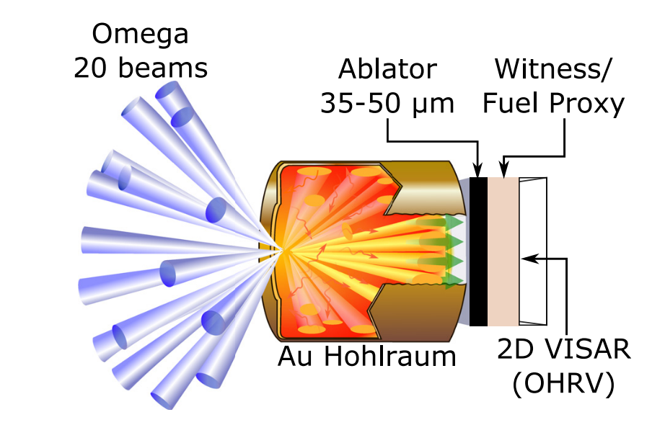
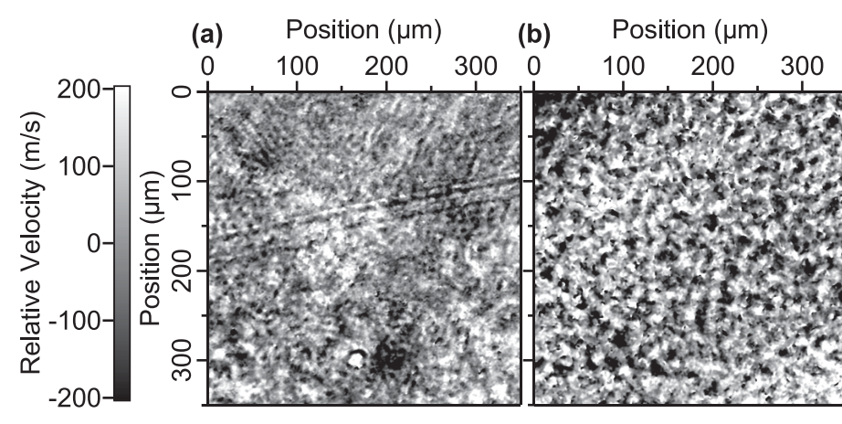
Experiments at Omega suggest that HDC microstructure may induce fluid instabilities
Material heterogeneity can seed instabilities. Due to shock speed varying as it passes through grains of differing orientations.
Can use 2D VISAR to measure the velocity nonuniformity at the shock front after it passes through the ablator
Experimental setup
2D VISAR of HDC at (a) 10 Mbar (b) 7 Mbar
Bottom: Ali, S. J. et al. Probing the seeding of hydrodynamic instabilities from nonuniformities in ablator materials using 2D velocimetry. Phys. Plasmas 25, (2018).
Notes:
The reason we care to model ablator microstructure is because recent experiments at omega have shown that the microstructure of such materials can induce fluid instabilities in HED experiments such as those at NIF
A schematic of these experiments is shown in the bottom left
Here, 20 Omega lasers are shone into a gold hohlraum and the goal is to use 2D visar (a velocity interferometry technique) to observe the shock wave after it passes through the ablator and into the fuel
2D VISAR creates a map of the relative velocity of the shock front at a given point in time, as shown in the bottom right
In this case, we can clearly see how nonuniform the velocity is across the front
---
50 s
---
VISAR: measures changes in doppler shift of light reflected off moving surface. The Doppler effect (or the Doppler shift) is the change in frequency of a wave in relation to an observer who is moving relative to the wave source
FIG. 1. Target design for the described experiments. For cryogenic experi- ments, the witness layer is a DT fuel proxy of liquid D2; for warm experi- ments, polymethyl-methacrylate (PMMA) is used. The witness layer is required for both GDP and Be samples, as they are not transparent to the 400nm probe wavelength, and the D2 layer allows for the observation of roughness on deep release into a DT-like material.
FIG. 9. (a) Velocity map of an opti- cally reflective shock in 0.5 ns liquid D2 after the breakout from HDC at 10 Mbar; velocity rms is 86 m/s. (b) Same as (a), at 7 Mbar; velocity rms is 125 m/s. (c) Same as (a), but under warm conditions in PMMA instead of cryo- genic D2; velocity rms is 55 m/s. The rms is calculated over the wavelengths of 5–100lm
“This can lead to variations in the shock speed in crystallites of different orientations, poten- tially seeding instabilities.”
“R).22 This instrument pro- vides a velocity map of the perturbed shock front with ?5 lm spatial resolution and velocity resolution <10 m/s”

Slide 15
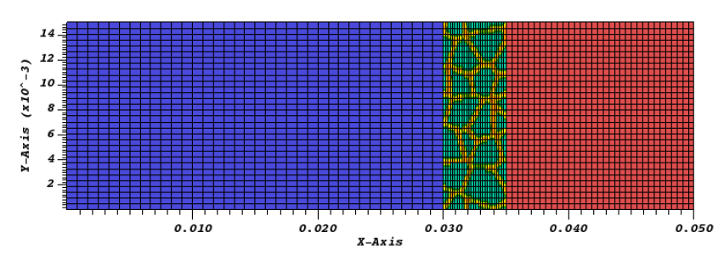
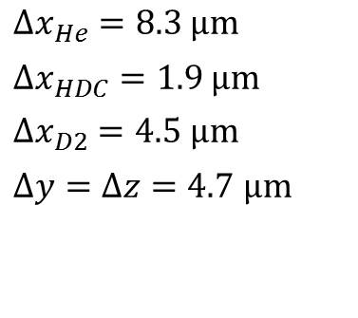
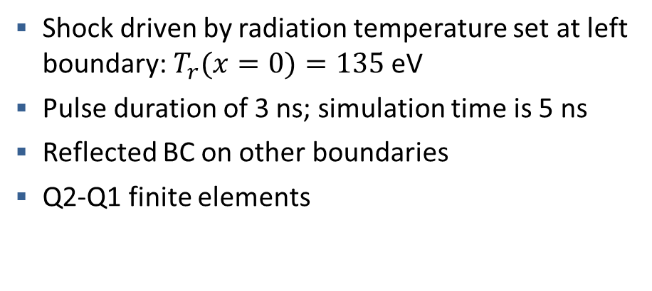
To resolve the physics in the experiment, we focus on a small section of the irradiated area
Numerical considerations
Shock driven by radiation temperature set at left boundary: $T_{r}(x=0)=135$eV
Pulse duration of 3 ns; simulation time is 5 ns
Reflected BC on other boundaries
Q2-Q1 finite elements
He
HDC
D2
$Δx_{He}=8.3$ $μm$
$Δx_{HDC}=1.9$ $μm$
$Δx_{D2}=4.5$ $μm$
$Δy=Δz=4.7$ $μm$
Top left: Ali, S. J. et al. Probing the seeding of hydrodynamic instabilities from nonuniformities in ablator materials using 2D velocimetry. Phys. Plasmas 25, (2018).
Notes:
Focus on small section and display mesh
Point on radiation temperature BC
---
1 min
---
Reflecting boundary conditions on all but irradiated wall
Symmetry BCs on all walls for hydro

Slide 16
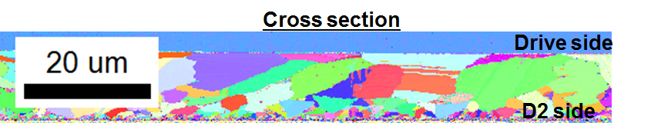
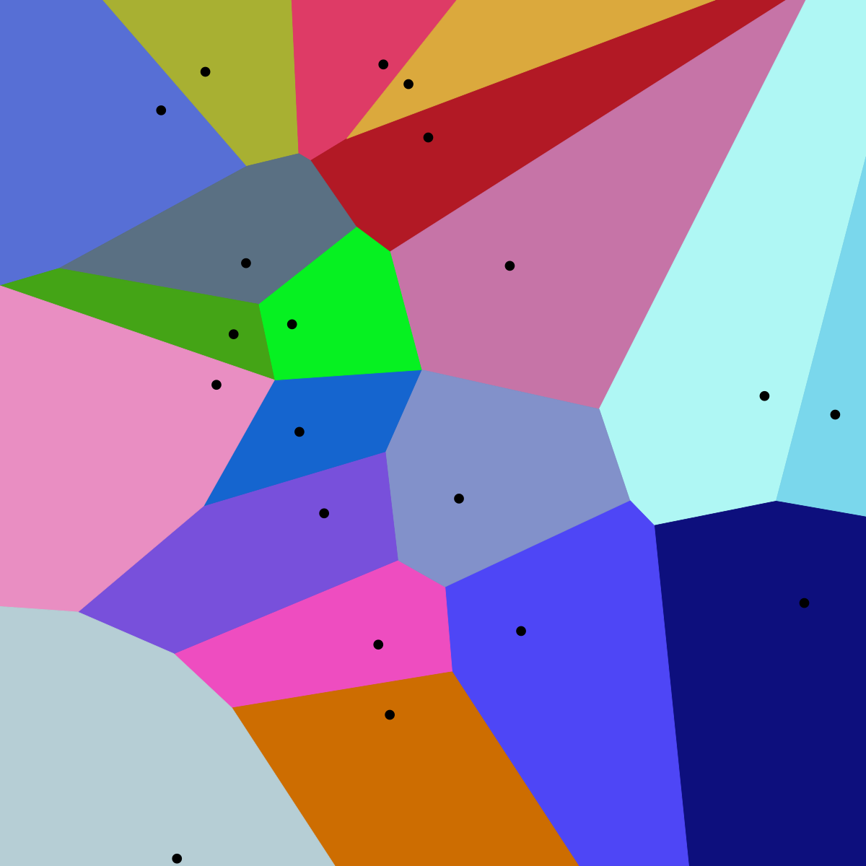
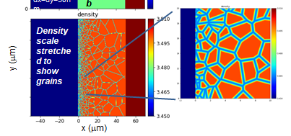
We can simulate a realistic HDC microstructure via a Voronoi tessellation
HDC has a polycrystalline microstructure with grains ranging from 1 to 20 microns in size
Voronoi tessellation
Previous 2D microstructure modeling by Chris Weber using HYDRA
Top: Data collected and processed by D. Rosas, D. Bober, and E. Sedillo
Bottom right: Weber C. APS. 2019;2019:GI3-001.
Notes:
How to model microstructure
Shown on the top is an SEM image demonstrating the polycrystalline structure and the wide range of grain sizes that HDC posses
Previous work in 2D used Voronoi tessellation to mimic this structure
Define tessellation in terms of cells.
Generating points / seeds
Set of points that are closer to a given seed than any other.
Given this tessellation, you can use it to define an initial density field in the HDC region
This is precisely what Chris Weber did previously in 2D using the HYDRA code, which is shown in the bottom right
Here you can see the grain boundaries, which are graphite, are at a lower density than the interiors which are essentially diamond
---
1 min 15 s
---
Grains vary from 1 to 20 microns.
Basically what were dealing with in HDC microstructure is grains of diamond that are ~100nm – several microns in size and the regions between the grains are graphitic with a density of ~2.2 vs 3.5 g/cc. This graphite region is about 4nm thick in reality

Slide 17
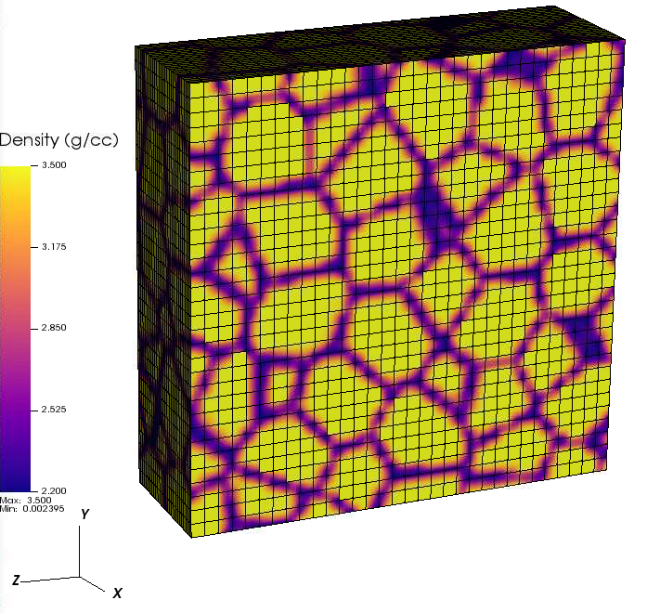
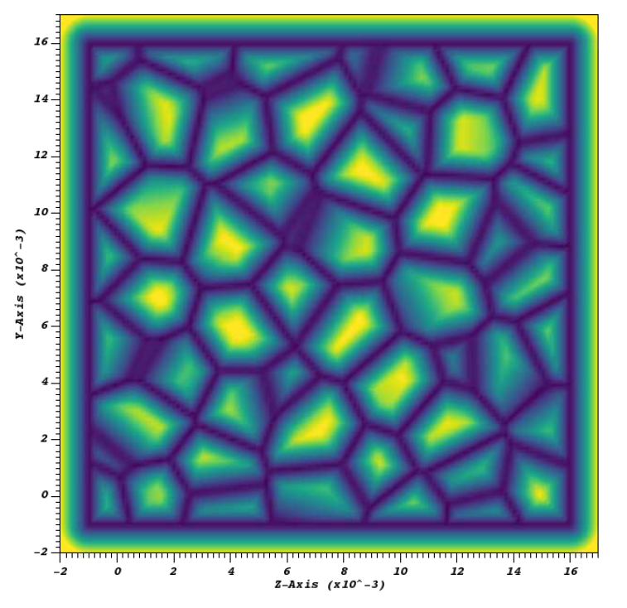
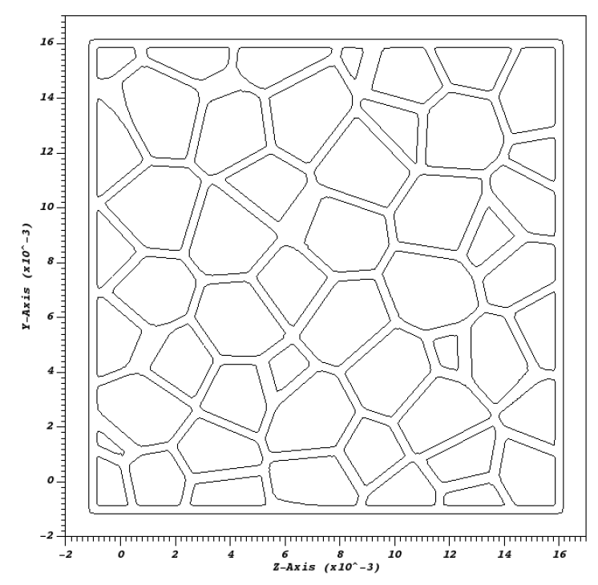
Axom allows us to create a full workflow for generating 3D Voronoi microstructures
Creation of polygon mesh
using MicroStructPy
Generate initial density for MARBL using Axom
Use an isosurface to define grain boundaries
Generate distance field using Axom
MicroStructPy: K. A. Hart and J. J. Rimoli, Computer Methods in Applied Mechanics and Engineering, 370 (2020), pp. 113242.
Notes:
In 3D too we’d like to create an initial density field as well but the workflow is a little bit more involved
The first step is…
Distance field that measures the distance from the boundaries of this polygon mesh.
---
1 min 15 s
---
Project to 2D flips the axes (reflection of z)

Slide 18
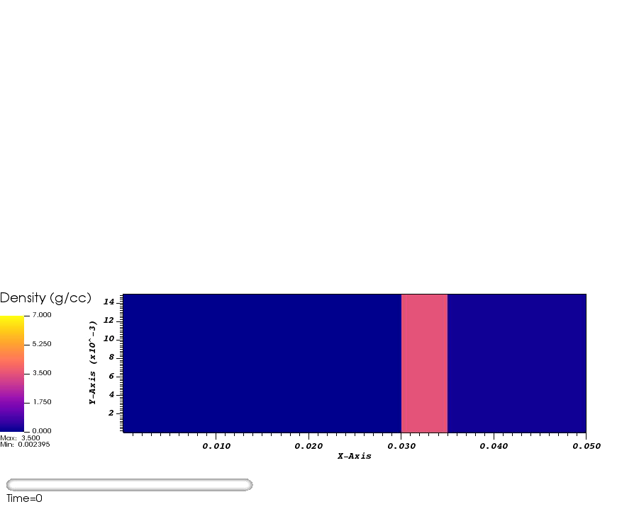

The presence of the microstructure has a clear impact on the dynamics of the shock
Nominal
Microstructure
* These are both 3D MARBL simulations viewed from the side
Notes:
So what is the effect of the microstructure, which we’ve created by constructing this non-uniform density in the HDC region?
First without (and mention these are side on views)
Then with
Shock travels faster through the graphtite
---
Explain 3 materials here

Slide 19
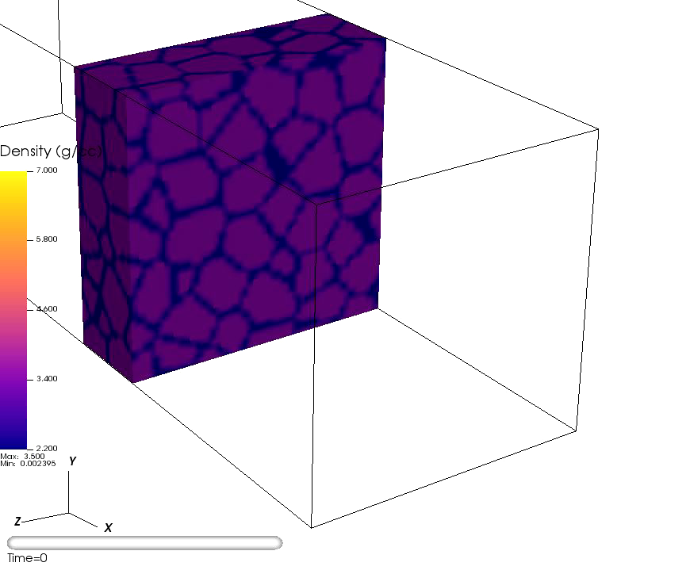
The presence of the microstructure has a clear impact on the dynamics of the shock
Notes:
---
1 min 15s for this and last slide

Slide 20
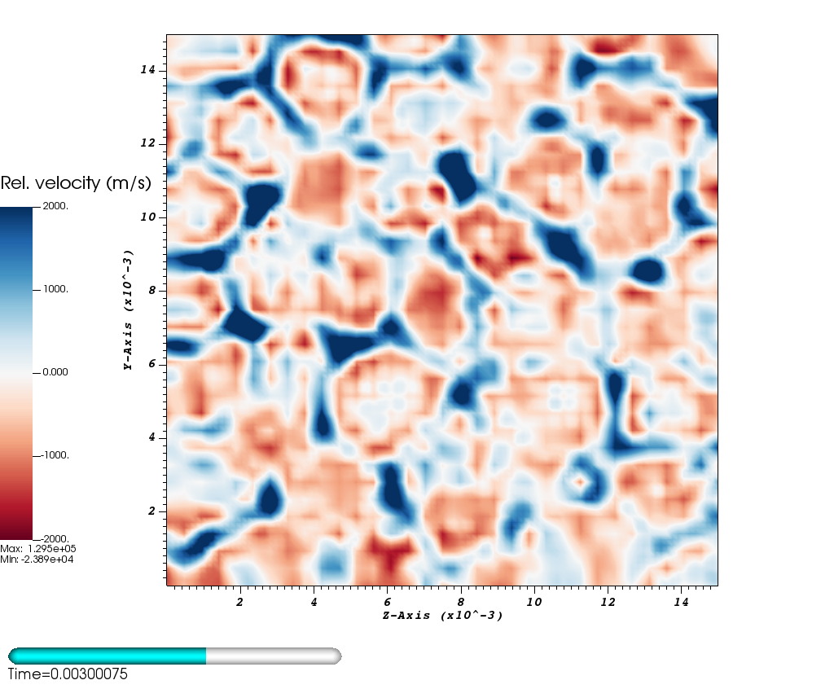
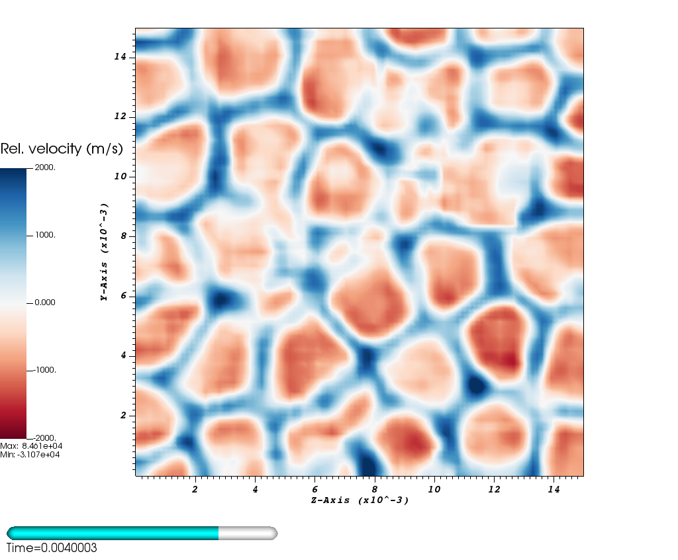
Visualizing the shock front gives insight into how the microstructure affects shock propagation
Relative velocity at the shock front 1 ns after breakout
Relative velocity at the shock front 2 ns after breakout
Notes:
Now we’ve only just started to quantify how the microstructure impacts the dynamics of the shock, but one thing we can visualize is the relative velocity of the shock front as was done in the experiments
Explain colors
What they mean -> microstructure seems to imprint this structure on the shock front at long times as the plasma travels through the less dense grain boundaries
---
1 min

Slide 21
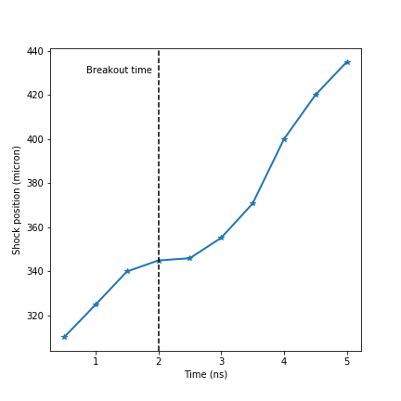
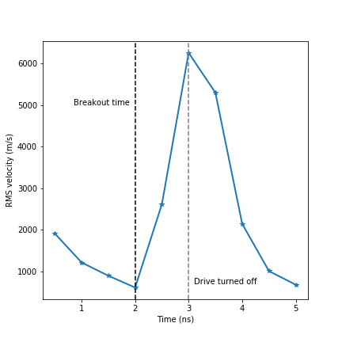
Ascent in-situ visualization provides us with quantitative information about the shock front
Shock position
RMS velocity of the shock front
Notes:
There’s a few other quantities we’ve started to look at to quantify what’s going on
Using the Ascent in-situ visualization tool we can determine the shock’s position during the course of the simulation as shown on the left
Knowing the shock’s position,
---
1 min 15 s

Slide 22
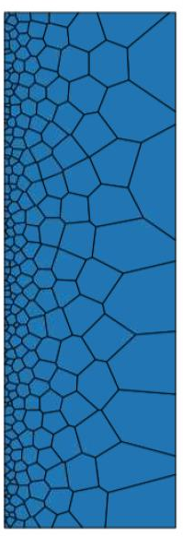
Key takeaways and future work for Part II
Key takeaways
We’ve created a general workflow for embedding a specified microstructure into MARBL 3D rad-hydro simulations
Simulations demonstrate the potential microstructure has for seeding fluid instabilities
Future work
Better replicate experimental microstructures (i.e. smaller grain sizes and considering spatial gradients)
Minimize computational cost as the problem becomes increasingly multiscale due to the extremely fine grain structures
Early results for simulated microstructure
SEM Image
Notes:
---
1 min
---
Lessons learned from MARBL and this problem
Maximum tmop limit scale isn’t better

Slide 23
In conclusion
The new multiphysics code MARBL is now at the stage where it can be used as a tool for scientific discovery
We’ve successfully used MARBL to model two high energy density experiments at Omega:
Radiation Kelvin-Helmholtz instability in a Magnetic Field
HDC microstructure seeding fluid instabilities
Notes:
--
30 s

Slide 24
Acknowledgements
Mentor
Luc Peterson
LLNL Collaborators
Rob Rieben, Kenny Weiss, Matt Larsen, Dan White, Suzanne Ali
HEDP Program
Lee Ellison, Perry Chodash, Kim Rivera
Notes:
Luc – fantastic mentor who I’ve learned a ton from and who is always willing to answer any questions I have or to help me brainstorm ideas for my project
At one point or another I’ve bombarded each of these people with questions on the teams chat so I really appreciate how patient and helpful they were
Lee, Perry, and Kim for making this summer program a reality. I’m sure it wasn’t easy setting-up and coordinating a virtual program, but from my pov I think it went quite smoothly and I’m really glad we were able to still have it

Slide 25
Questions?
Disclaimer
This document was prepared as an account of work sponsored by an agency of the United States government. Neither the United States government nor Lawrence Livermore National Security, LLC, nor any of their employees makes any warranty, expressed or implied, or assumes any legal liability or responsibility for the accuracy, completeness, or usefulness of any information, apparatus, product, or process disclosed, or represents that its use would not infringe privately owned rights. Reference herein to any specific commercial product, process, or service by trade name, trademark, manufacturer, or otherwise does not necessarily constitute or imply its endorsement, recommendation, or favoring by the United States government or Lawrence Livermore National Security, LLC. The views and opinions of authors expressed herein do not necessarily state or reflect those of the United States government or Lawrence Livermore National Security, LLC, and shall not be used for advertising or product endorsement purposes.
Notes:
so with that I’d like to conclude my talk and open the floor for any questions

Slide 26
Extra slides

Slide 27
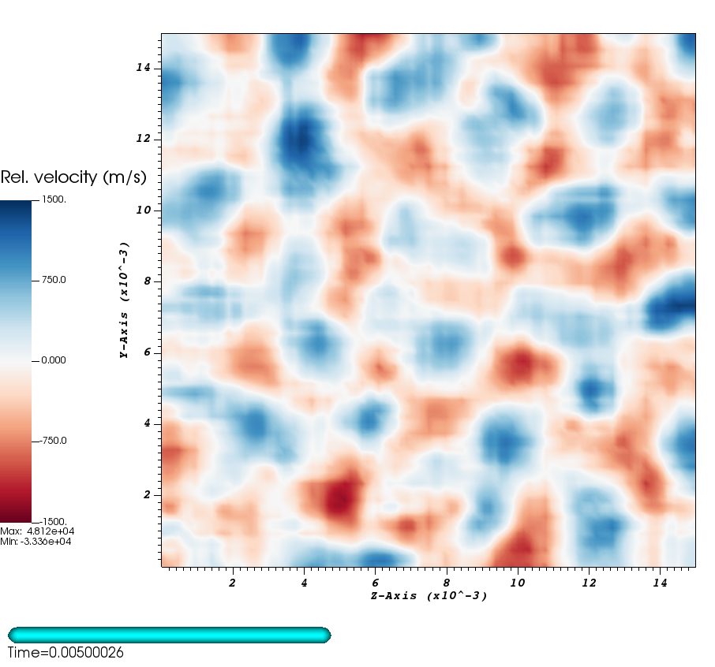
Visualizing the shock front gives insight into how the microstructure affects shock propagation
Relative velocity at the shock front 2 ns after breakout
Relative velocity at the shock front 3 ns after breakout
Bottom: Ali, S. J. et al. Probing the seeding of hydrodynamic instabilities from nonuniformities in ablator materials using 2D velocimetry. Phys. Plasmas 25, (2018).

Slide 28
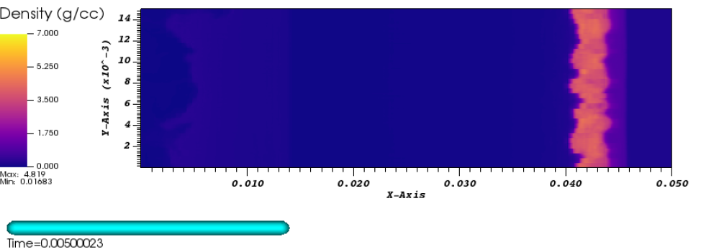
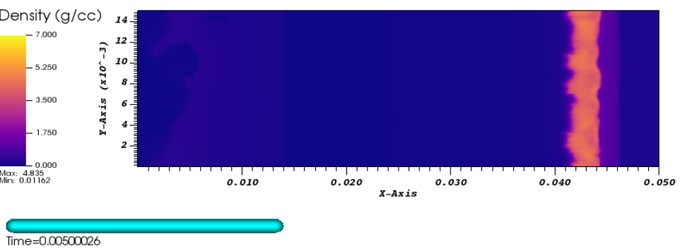
Changing limit scale from 8 to 3 and using mesh adaptation

Slide 29
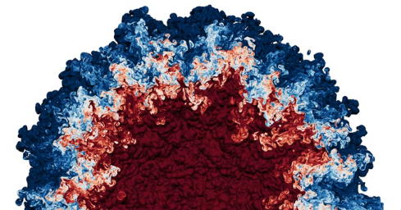
Fluid instabilities during ICF experiments lead to reduced capsule compression
ICF experiments can experience:
Rayleigh-Taylor instabilities
Richtmyer-Meshkov instabilities
Kelvin-Helmholtz (KH) instabilities
In all cases, the net result is mixing of cold fuel / ablator material into the forming hotspot, thereby decreasing fusion yield
My work has explored two interesting avenues of research:
Can magnetic fields be used to suppress fluid instabilities, e.g. the Kelvin-Helmholtz instability?
How does the microstructure of polycrystalline ablator material like high-density carbon (HDC) affect/trigger these instabilities?
Top right: https://doi.org/10.1103/APS.DFD.2019.GFM.V0002
Notes:
Start with conclusion – think of iphone example. What is the punchline of the talk?
Slides support spoken word. 15 distilled slides (e.g. slide 6). Conclusion -> evidence -> reiterate conclusion.
Contribution: setting up marbl for real-world icf experiments. Experiments that exercise its advanced capabilities.
Microstructre = amr, axom, higher-order
Mhd = mhd + radiation.
Real world prototypes to test algorithms. Unlike using tested-code for physics exploration.
Preliminary results of running these tough problems. “beyond test problems”.
Outline of talk: start with three main takeaways from the talk. (can figure this out now). List out supporting evidence. Form these into slides.
My work this summer is really centered around studying fluid instabilities that occur during ICF experiments at NIF
These fluid instabilities come in several flavors as I’ve listed at the top
Regardless of the type though, the net effect of these instabilities is that you end up mixing cold fuel with hot ablator material, thereby decreasing capsule compression and hence fusion yield
Recently, the presence of the kelvin-Helmholtz, or KH instability, was demonstrated in the context of a high-energy-density environment in a set of experiments conducted at Omega; their setup and results are shown below
Essentially, their setup consists of shining a laser on the LHS of a shock tube that is filled with carbon foam sitting atop a dense layer of plastic.
As the material heats up a shock wave is sent through the less dense foam on top and creates the characteristic swirling rollup patterns indicative of the KH instability
---
Instability occurs due to large velocity difference
Magnetic suppression of KH instability. First test of marbl with MHD and RHD.
Original experiment. Motivation was fluid instability in HED system – application to NIF
Application – use magnetic fields to suppress turbulent growth
Magnetic field lines frozen into fluid. Rebar for fluid.
We plan to look at e.g. mixing width
Challenge is MHD and radiation modeling is expensive. Twisting of KH instability makes it challenging numerically (distorts mesh).

Slide 30
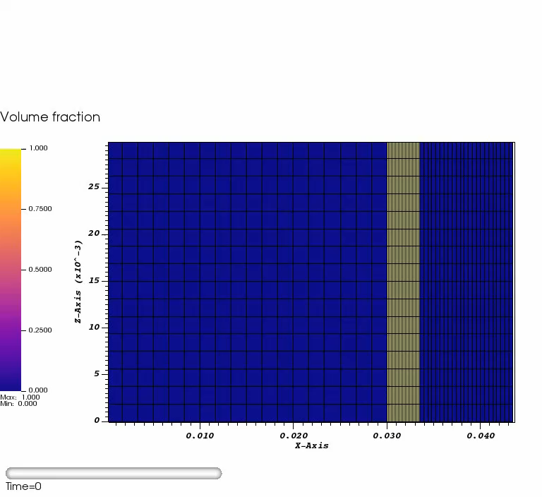
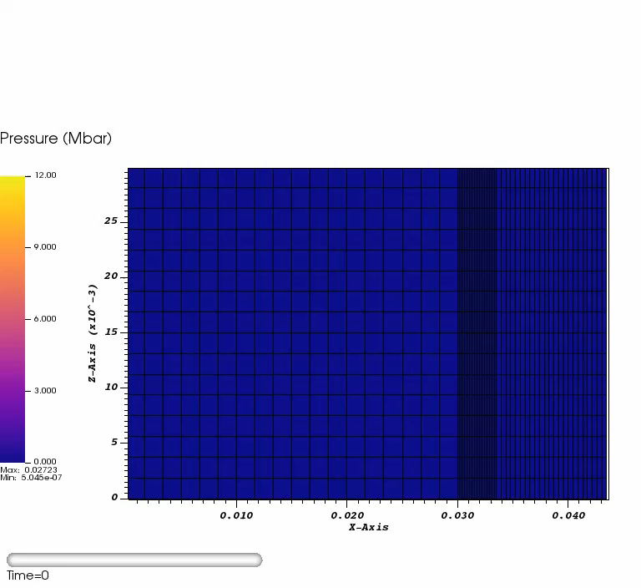
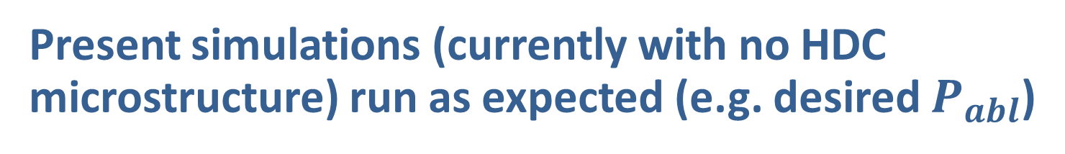
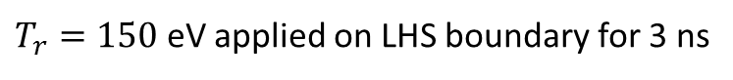
Present simulations (currently with no HDC microstructure) run as expected (e.g. desired $P_{abl}$)
The following are 3D simulations viewed at the $z=0$ plane
Ablation of the HDC region
Propagation of the shock wave
Goal 1: want first shock pressure > 12 Mbar so HDC is fully melted
Goal 2: want sufficient time after breakout to observe shock front
$T_{r}=150$ eV applied on LHS boundary for 3 ns
Notes:
A black body or blackbody is an idealized physical body that absorbs all incident electromagnetic radiation, regardless of frequency or angle of incidence. The name "black body" is given because it absorbs radiation in all frequencies, not because it only absorbs: a black body can emit black-body radiation. On the contrary, a white body is one with a "rough surface that reflects all incident rays completely and uniformly in all directions."^{[1]}
The Stefan–Boltzmann law describes the power radiated from a black body in terms of its temperature. Specifically, the Stefan–Boltzmann law states that the total energy radiated per unit surface area of a black body across all wavelengths per unit time (also known as the black-body radiant emittance) is directly proportional to the fourth power of the black body's thermodynamic temperature T:

Slide 31
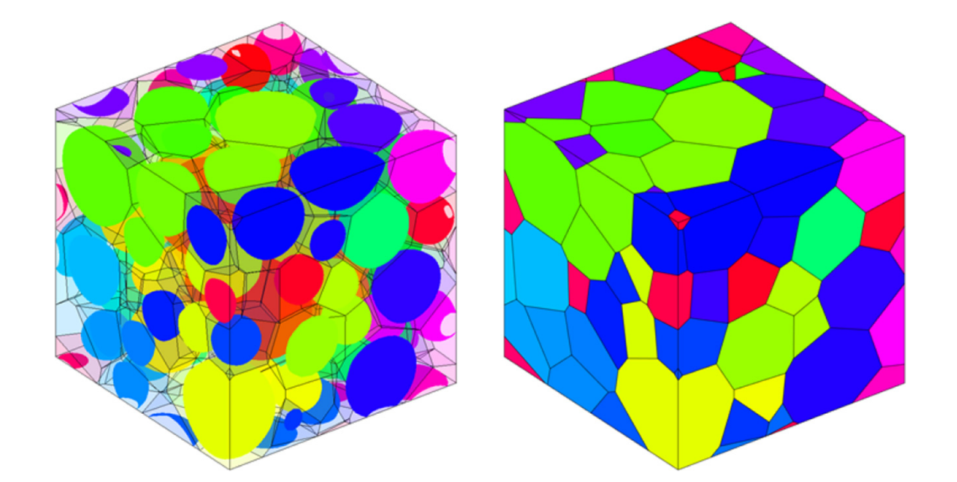
Next steps include modeling the HDC microstructure in 3D using a Voronoi tesselation
HDC has a polycrystalline microstructure with grains ranging from 1 to 20 microns in size
Previous 2D microstructure modeling by Chris Weber
Laguerre-Voronoi tessellation
Top: Data collected and processed by D. Rosas, D. Bober, and E. Sedillo
Bottom right: Falco, S., Jiang, J., De Cola, F. & Petrinic, N. Comput. Mater. Sci. 136, 20–28 (2017).
Notes:
Grains vary from 1 to 20 microns.

